Slide 1


MSIS 2604
Information Systems Policy and Strategy
AI / Automation Project
Team Musafir -
Amey Darwhekar, Anjali Gupta, Jhaanvi Golani,
Pratik Deshmukh & Surbhi Zambad
Notes:
A fruitful evening to everyone, we are team Musafir and today, we are here to present our project Airbnb. First I would like to take this opportunity to thank our professor for being there throughout the journey to guide and support us

Slide 2

Company Profile
ABOUT
VISION
MISSION
A web platform where users can rent out their space to host travelers.
Belong anywhere.
Help create a world where you can belong anywhere and where people can live in a place,
instead of just traveling to it.
Notes:
My name is Anjali and I will walk you through the company’s profile. Airbnb is a web platform where users can host the travelers by providing their spaces.

Slide 3
Overview
Airbnb’s accommodation marketplace provides access to 6+ million unique places to stay in more than 81,000 cities and 191 countries
With experiences, Airbnb offers unprecedented access to local communities and interests through 25,000+ unique, handcrafted activities run by hosts across, 1,000 + markets around the world.
Airbnb is a global community of hosts and travelers, who have welcomed more than 1 billion guest arrivals.
Notes:
Here are some facts and figures related to the company. Airbnb has access to 6+ million unique places, in 81,000 cities and 191 countries..
It also has access to 1000+ markets around the world and has already welcomed 1B+ guest arrivals

Slide 4
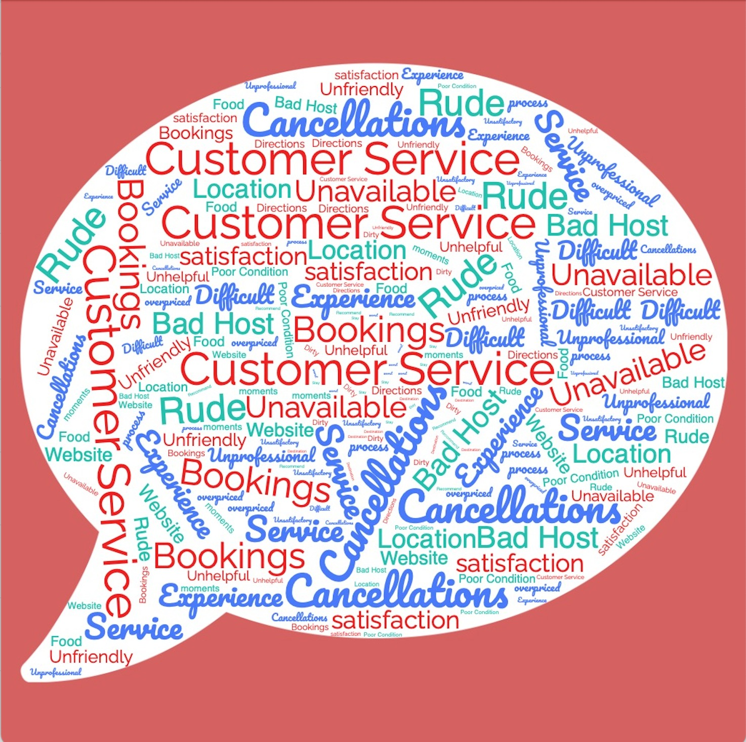
Word cloud from Reddit, Quora and Google Reviews
Notes:
Here is a wordcloud which we have drawn with the help of reviews taken from reddit, quora and google.

Slide 5
Current problems
It is difficult for users to book Airbnb’s based on highly specific location based requirements
There is a lot of friction for modifying bookings, cancellations and updates
Customers cannot export the location / check nearby locations / points of interests
Targeted information is not available for each listing
Notes:
And here are some conclusions which we have drawn with the help of it. Some of the current problems in the company are …

Slide 6

Proposed Solution
Life-like conversational AI / Virtual Assistant who can answer customers specific questions while browsing and comparing listings and dealing with cancellation.
Additionally, the virtual assistant has the functionality to be a voice assistant in the mobile app.
Notes:
Pratik
To overcome these challenges, we are proposing the inclusion of a Like like conversational AI / Virtual Assistant

Slide 7
Business Level Strategic Drivers
Personalization
Innovation
Google Maps is integrated in every listing. But since the address is masked for privacy, users cannot export the location and search for nearby amenities / requirements. With our solution, we will address this issue and make the search highly personalized.
With the introduction of conversational AI and voice assistant (for the mobile app) we will frog-leap in the future to make the booking process customised for the user.
Notes:
Pratik
Vrbo already has a “whats nearby” feature. To bridge the gap and get a strategic advantage over the competitors, we plan to integrate conver Ai/voice assistants suggesting what’s nearby which will make airbnb perfect place for guests who don’t want to spend a lot of their time researching the best deals. Also If the owner unexpectedly cancels your reservation within 30 days of your stay, the assistant will help you find a comparable property.

Slide 8

Objectives and Goals of the Digital Transformation
Improve customer experience
Ease of booking using Voice Assistant
Explore Airbnb options based on highly specific personal preferences
Staying ahead of competition
Notes:
Pratik
To overcome these challenges, we are proposing the inclusion of a Like like conversational AI / Virtual Assistant

Slide 9

Capability assessment of Current State
They have an integrated layer of Google Maps API to visually show and mask (for privacy) the current location of the listing
This means that internally Google APIs are being used and customised
Hence, we will be leveraging the current state by integrating Google based APIs for our solution
Notes:
Pratik

Slide 10
Digital Capabilities leveraging AI and Automation
GOOGLE ASSISTANT (Voice) API
GOOGLE DIALOGFLOW
The Google Speech API is a sophisticated tool that uses Google’s machine learning technology to convert voice to text
Lifelike conversational AI with state-of-the-art virtual agents
Notes:
Pratik

Slide 11
Gap Analysis
FROM
TO
No Custom Search options: Limited information available about the nearby places
Increased Customer Support Backlog
Average User experience
Delayed Responses
Targeted information available: Virtual Assistant can answer questions regarding nearby locations
Decrease in Customer Support tickets
Enhanced Customer experience
Quick Responses
Notes:
Jhaanvi(2:15)
In the gap analysis
As discussed before as well, From having no custom search options we are now going to provide personalized information, where virtual assistant can answer questions regarding nearby locations
And we believe this would lead us from our current state which is increased customer support hours or backlog, average user experience and delayed response time to decrease in in customer support tickets backlog, improved customer experience and instant responses

Slide 12
Main Competitors to AirBnB
Vrbo
Vrbo is an American vacation rental online marketplace originally known as Vacation Rentals by Owner.
Vrbo was founded in 1995 and now is owned by the Expedia Group.
Glamping Hub
It is a San Francisco-based startup of 54 employees and the world's leading curated online booking platform, dedicated to unique accommodations in nature and truly inspiring rentals
Notes:
Jhaanvi
Talking about the competitors, The two main competitors of airbnb are Vrbo and Glamping hub. Vrbo offers stand-alone vacation homes only and does not offer “shared” spaces like private rooms or more unusual options like campsites while .Glamping Hub provides peer-to-peer rentals similar to VRBO and Airbnb but Unlike these sites,Glamping Hub rentals is all about unique accommodations in nature. Airbnb offers all three stand-alone vacation homes as well as shared spaces and even hotel rooms.

Slide 13
Strategic Advantage
Vrbo
Glamping Hub
Vrbo already has a “What’s nearby?” feature, with Google Maps integrated in every listing, which Airbnb lacks.
With our solution, we will match this capability and frog-leap with the conversational AI / voice assistant.
Glamping Hub doesn’t have the exact location of the property and there is no functionality to check what is located around the property.
There is no Virtual / Voice Assistant either.
Notes:
Jhaanvi
1)Talking about the strategic advantage , Vrbo has a “ nearby activities” feature but no voice assistant and Glamping Hub currently has no functionality to check what’s nearby the property
2) so To gain a competitive advantage, we plan to integrate conversational AI suggesting what’s nearby which will make airbnb perfect place for guests who don’t want to spend a lot of their time researching the best deals which in turn can help us in increasing overall property bookings and enhancing customer engagement

Slide 14
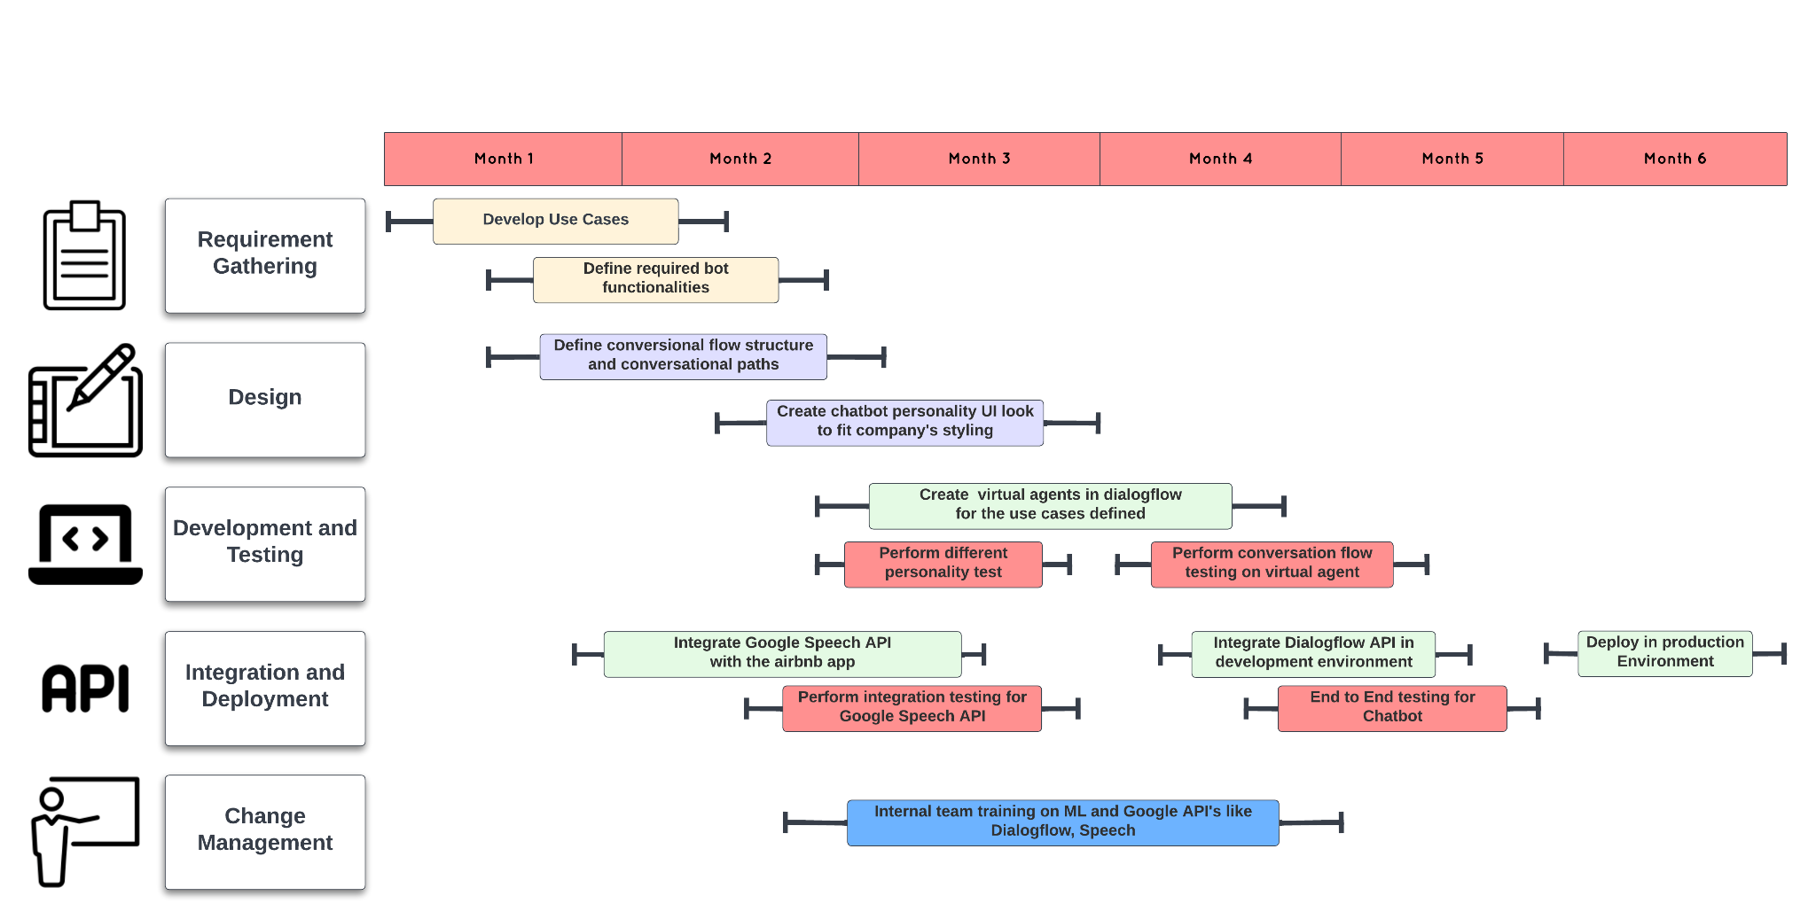
Timeline / Roadmap
Notes:
Jhaanvi
This is the roadmap for introducing conversational AI into the ecosystem.
the initial focus is on requirement gathering and development of use cases followed by designing the conversation flow structure (for eg booking a stay, and customer queries like how far is starbucks from the listing). Simultaneously we are also integrating google speech API on airbnb app for converting text to speech and speech to text.
Next in the line is creating chatbot persona as per company styling, and for the development we would be creating virtual agents in google dialog flow for the use cases defined. For each development module, we perform a unit testing, in the end we integrate everything in the testing environment to perform end to end testing. Once validated, it is deployed in production environment

Slide 15

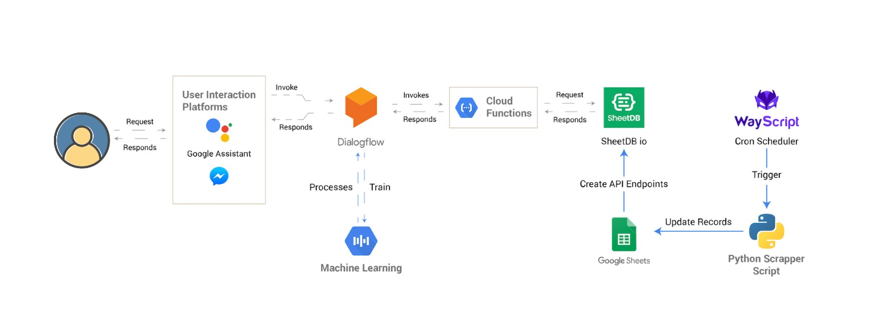
Architecture of the AI chatbot
Notes:
Amey

Slide 16
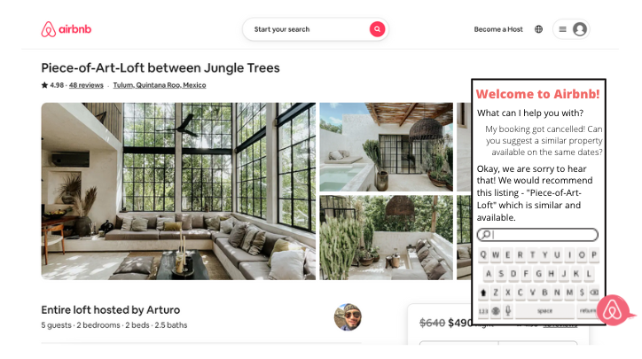
UI Design for website / Phone - Chatbot
Notes:
Amey
Review 2nd point
Icons and structure
CCP and GDPR

Slide 17
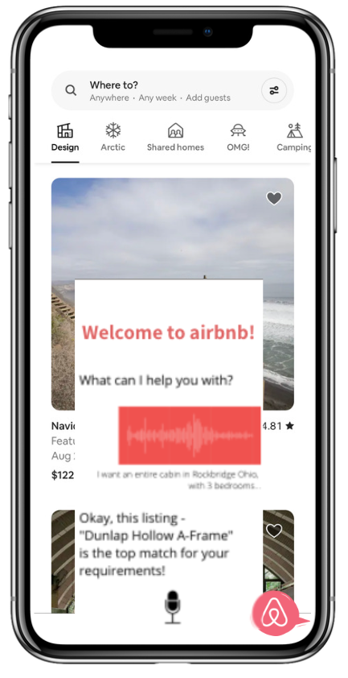
UI Design for Phone - Voice Assistant
Notes:
Amey

Slide 18
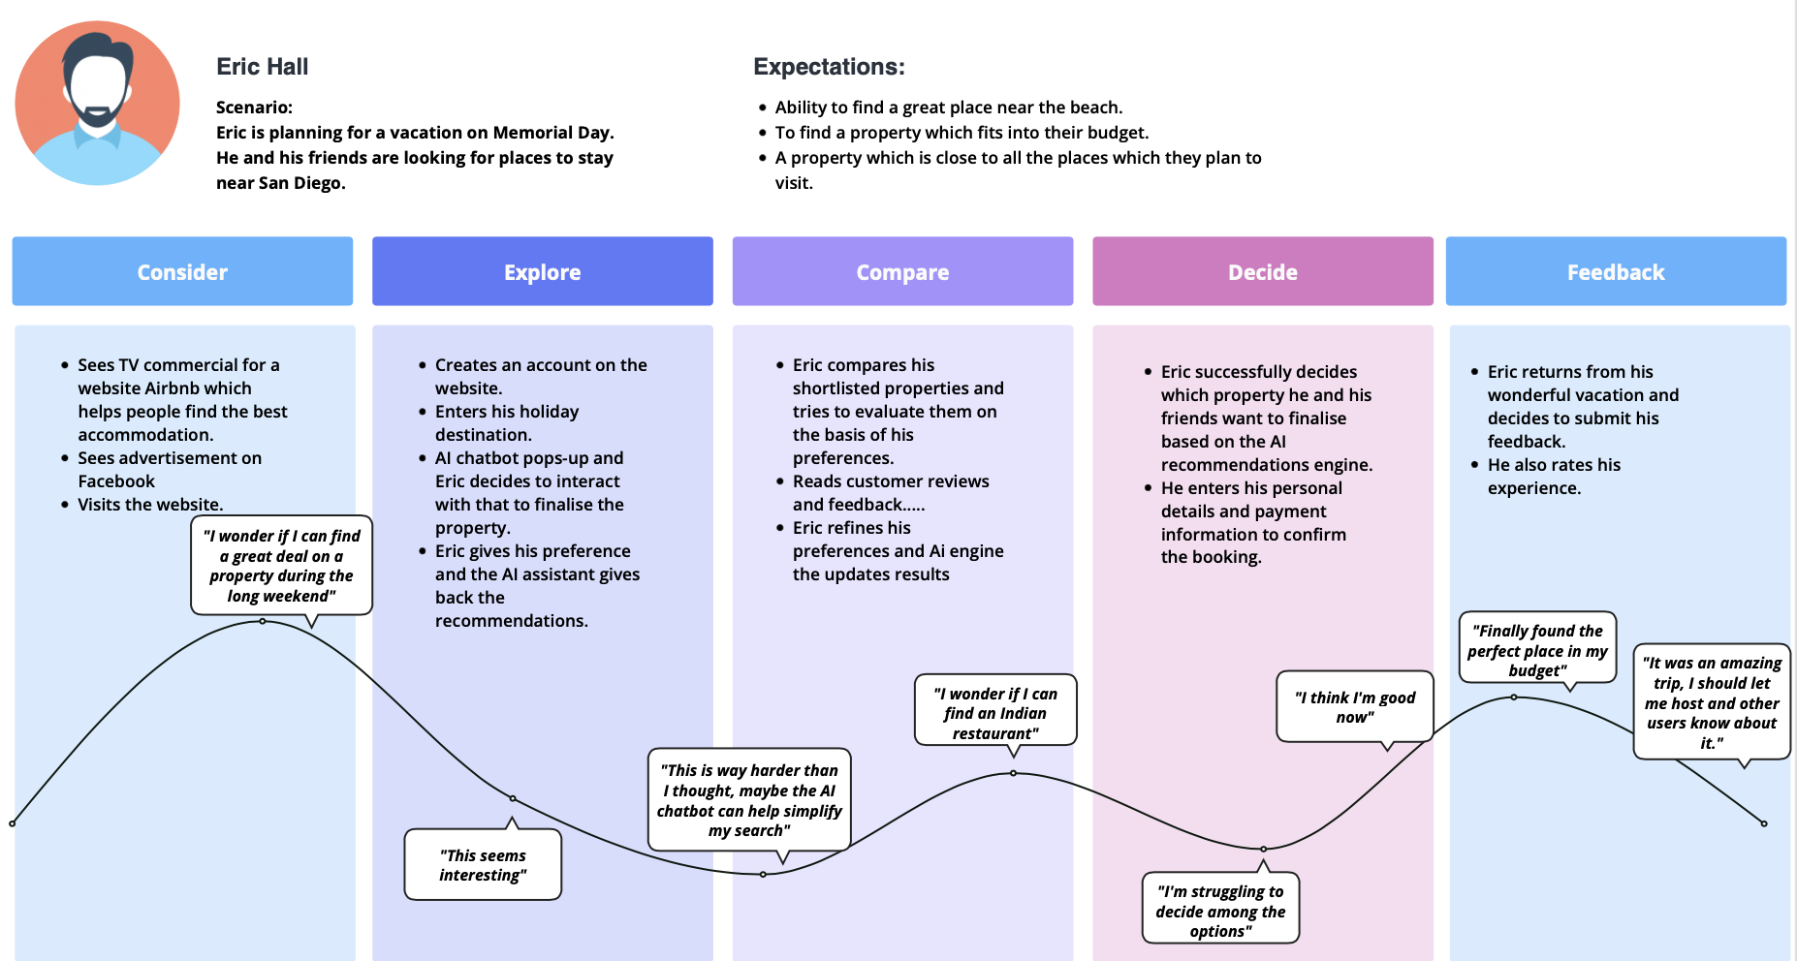
Customer Journey Map
Notes:
Amey

Slide 19



Data Privacy
Risk and Mitigation
Risk:
Sensitive data leakage
Mitigation:
End to end Encryption
Self destructing message are a practical solution.
Risk:
Third party API integration comes with potential security risks such as:
User and function level authorization
Security misconfiguration
Mitigation:
Use tokens and OAuth for authentication and authorization
Use an API Gateway to monitor API traffic
Security
Risk:
The conversational AI market is oversaturated with many chatbots which are not well tested in the real world
Mitigation:
Choose an established vendor who provides technology with proven results.
Working with experts means benefit from their many years of experience, thereby making the investment less risky
High Risk Financial Investment
Notes:
Surbhi
With Intelligent Systems, comes risks. As technology advances, and it always will, organizations need to be aware of the important steps in mitigating risks. Let’s see what risks the planned Chatbot might pose the systems and ways we can mitigate it.
1)DATA Privacy: Which is of a huge concern for the customer as well as the organisation. To mitigate this we can do a e-e encryption or send Messages containing Personally Identifiable Information (PII) are automatically desensitized after the chat session ends
2)Security: this can be handled by using tokens FOR AUTHENTICATIONS and API GATEWAY TO MONITOR API TRAFFIC. 3) Yes I know it is a high risk Financial investment for the investors as there are plethora of chatbots in the market which are not well tested. To mitigate this we can choose a established vendor

Slide 20
Data Privacy
Policies and Regulations
California Consumer Privacy Act (CCPA):
Airbnb Payments will not share information it collects about customers with its affiliates or third parties (both financial and non-financial), except as required or permitted by your state’s law.
Privacy Policy for the United States:
Personal Information collected:
Information needed to use the Airbnb Platform:
Contact Information, Account, Profile Information, Identity Verification and Payment Information
Information customers choose to give:
Additional Profile Information (Such as gender, preferred language(s), city), Address Book Contact Information, Other Information (add information to your account, respond to surveys, post to community forums, participate in promotions, communicate with the customer care team)
Information Automatically Collected by Using the Airbnb Platform and our Payment Services:
Geo-location Information, Usage Information, Log Data and Device Information, Cookies and Similar Technologies as described in our Cookie Policy, Payment Transaction Information
Personal Information collected from Third Parties:
Background Information, Enterprise Product Invitations and Account Management, Referrals and co-travelers
Security
Notes:
Surbhi
Policies and Regulation on the state level followed by Airbnb are:
CALIFORNIA CONSUMER PRIAVCY ACT. AIRBNB WILL NOT SHARE ANY PERSONAL INFORMATION ABOUT CONSTUMOR
Privacy policy included:contact info,account,profile information will be taken from customer.
Customer chooses to give the other additional information
Information that will be automatically collected included geolocation,logscookies
Personal information can be collected from third party.
https://www.airbnb.com/help/article/3176/privacy-policy-for-the-united-states
https://www.airbnb.com/help/article/2863/california-and-vermont

Slide 21
Internal and external analysis
Internal
Revenue Reports
Customer metric KPIs
External
Airbnb reviews from hosts and renters
Reddit Reviews
Google Reviews
Consumer Affairs website
Notes:
Surbhi
The internal and external analysis that needs to be done for the chatbot includes:
Going through the revenue report and customer metric in detail
External included reviews from different websites and extracting the sentiments from user.
Using both internal and external sources we will be doing the analysis

Slide 22
Evaluation Metrics
Targeted information is not available for each listing
Time Saved - Average time in booking, per user, has to reduce
Enhanced User Experience - Positive Sentiment in Review analysis
Percentage of users using the chatbot - increase by 10% every quarter
Customer support - Decrease customer support tickets by 10% in every quarter
Customer Retention Rate - Percentage of repeat customers increased, quarterly by 10%
Revenue - Increase by 20% in 1 year
Increase in Traffic - Increase in traffic on site, quarterly by 25%
Notes:
And here are some conclusions which we have drawn with the help of it. Some of the current problems in the company are …

Slide 23
Resources
Human Resources
App Developers / Web-developers
Research Team
Data Analysis Team
Sales / Marketing Team
Machine Learning & Artificial Intelligence Team
Technology Stack
Google APIs (Dialogflow, Speech API, Google Maps API)
Machine Learning & Artificial Intelligence
Notes:
Resources required to implement the chatbot are:
Human Workforce :
Technology
Time and money

Slide 24
Change Management
We are introducing a new functionality, so the change will primarily be customer facing.
Promotions and Marketing
Events
Internally we would need team trainings (AI/ML and support teams)
Notes:
Pratik
To overcome these challenges, we are proposing the inclusion of a Like like conversational AI / Virtual Assistant

Slide 25
Next steps
Integrate Flight booking websites / functionality with the chatbot.
Integrate local car rentals by tying up with the car rental companies.
Curating personalised itinerary for premium customers
Notes:
Pratik

Slide 26
Thank You!
From Team Musafir -
Amey Darwhekar, Anjali Gupta, Jhaanvi Golani,
Pratik Deshmukh & Surbhi Zambad
Notes:
Surbhi

